Slide 1
The ZONES of Regulation®

Slide 2
The ZONES of Regulation®
How many senses do we have?
Visual/Auditory/Smell/Taste/ Touch
Vestibular – Located in the inner ear, internal GPS of the body.
Proprioception – This is one of the internal senses of the body that comes from the joints, muscles, ligaments, and other connective tissue. It helps with body awareness.
Interoception –is a sense that provides information about the internal condition of our body—how our body is feeling on the inside.

Slide 3
The ZONES of Regulation®
Interoception – tells us how our body is feeling on the inside.
Internal
External

Slide 4
The ZONES of Regulation®
Every one experiences all feelings.
What differs is what we do about them or the behaviour we show.
Emotions, thoughts and what we do or feel an urge to do (behaviours) are all linked.
Emotional Regulation skills help us learn to effectively manage and change the way we feel and cope with situations.

Slide 5
The ZONES of Regulation®
Zones of regulation is a self regulation approach.
It focuses on emotions/feelings
There are 4 zones, identified by 4 colours.
Each zone has feelings.

Slide 6
The ZONES of Regulation®
There are no good or bad feelings.
There is no naughty zone.
But children engage better when in the green zone.

Slide 7
The ZONES of Regulation®
low level of arousal | Good state of alertness | heightened state of alertness | Extreme state of alertness
Happy
Angry
Bored
Excited
Focused
Sick
Frustrated
hitting

Slide 8
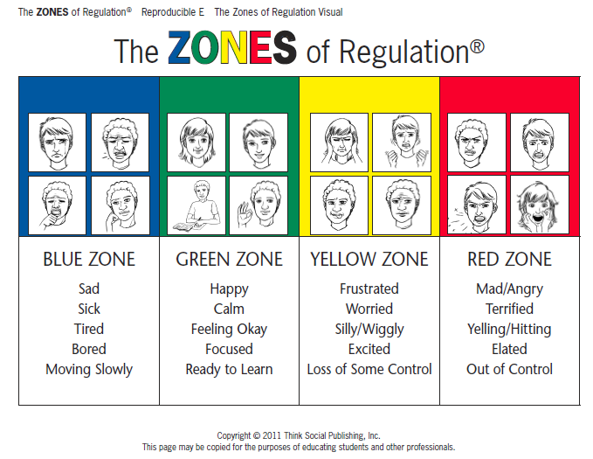
Zones of Regulation

Slide 9
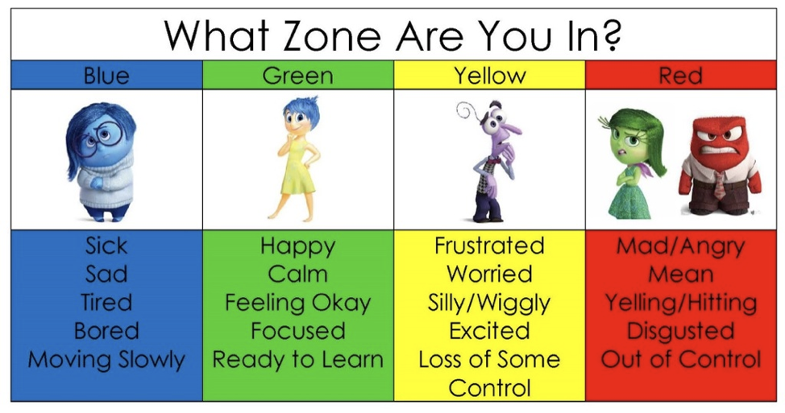

Slide 10
The ZONES of Regulation®
Pupils gain skills in consciously regulating their actions / behaviour.
It is a learnt behaviour taught explicitly and reinforced through shared language and common goals.
It leads to independent increased control and problem solving abilities.
Key aspects of teaching
to help children recognise when they are in different zones – what does that look like?
Teach children strategies or tools to stay in a zone or move from one to another.
These could be calming techniques, cognitive strategies, and sensory supports.
These strategies or tools are kept in their toolbox.

Slide 11
The ZONES of Regulation®
Tools

Slide 12
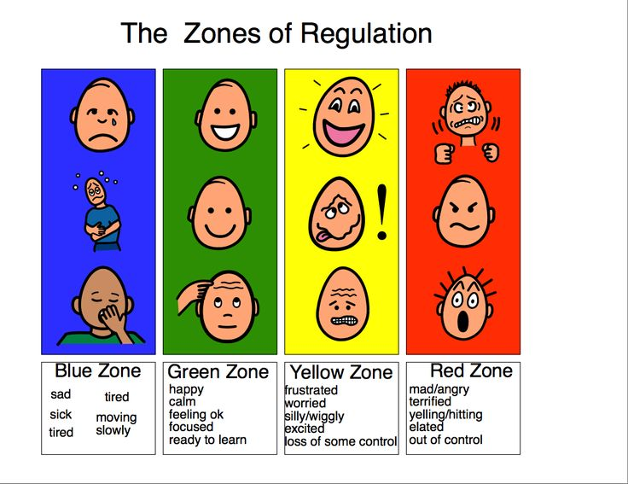

Slide 13
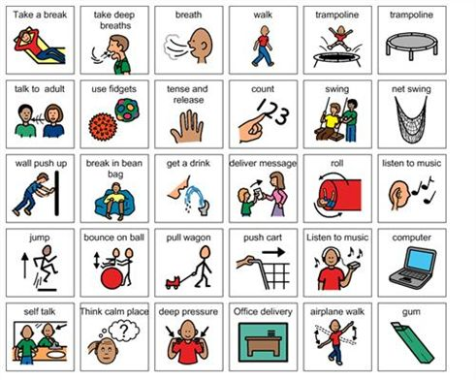

Slide 14
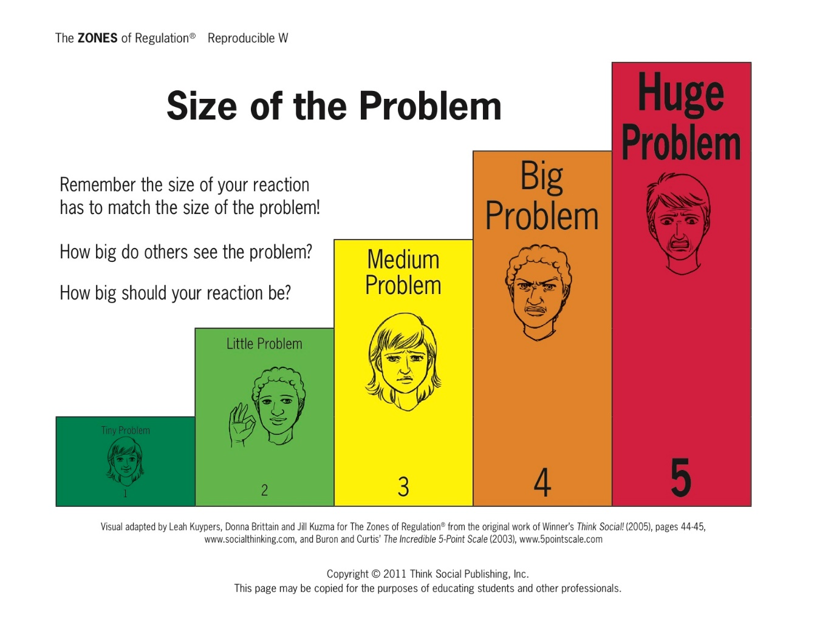

Slide 15
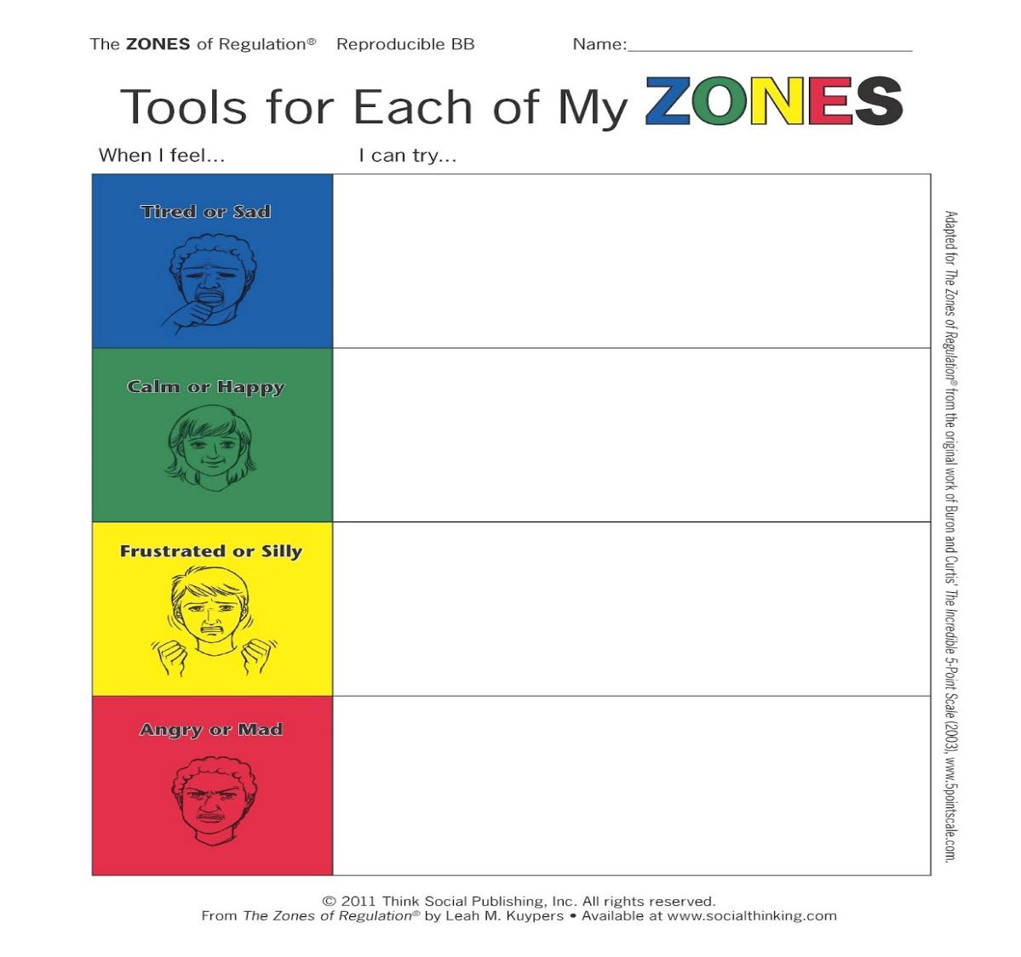

Slide 16
