Slide 1
Welcome to Year 3’s Curriculum meeting
Welcome

Slide 2
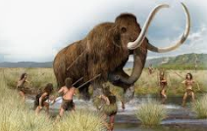
What does civilized mean?
Curriculum Map
Notes:
Each term’s topic focuses on a big question – In Autumn 1 pupils will be thinking about ‘What does civilized mean?’ which is linked to scavengers and settlers.
Topics are taught cross-curricular with a range of complementary texts. For example: we will study non-fiction texts about scavengers and settlers in Topic, a comic book in literacy and Stone Age cave paining in art etc.
This year the school will be taking part in a Poetry Slam, in addition to Poetry Week, Book Week, Science Week and Debate Week.
We are also introducing a new PSHE curriculum, that has been launched in Camden. PSHE lessons will be taught every week.

Slide 3
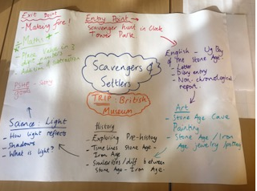
Half-term pacer

Slide 4
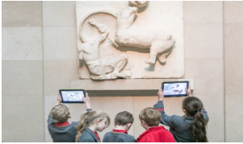
British Museum Workshop Monday 23rd September:
Tablet session led by teachers
Poetry performance Wednesday 9th October.
Trips
Notes:
.

Slide 5
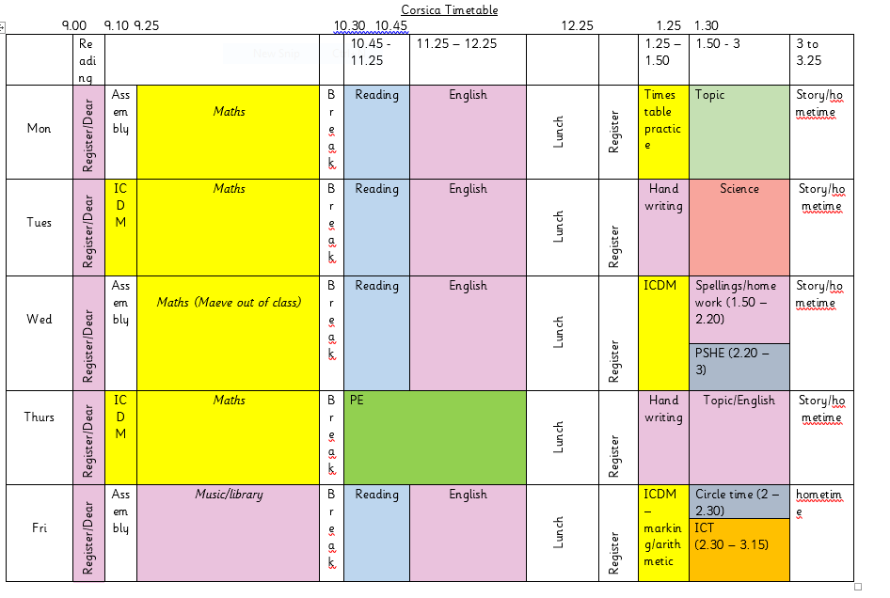
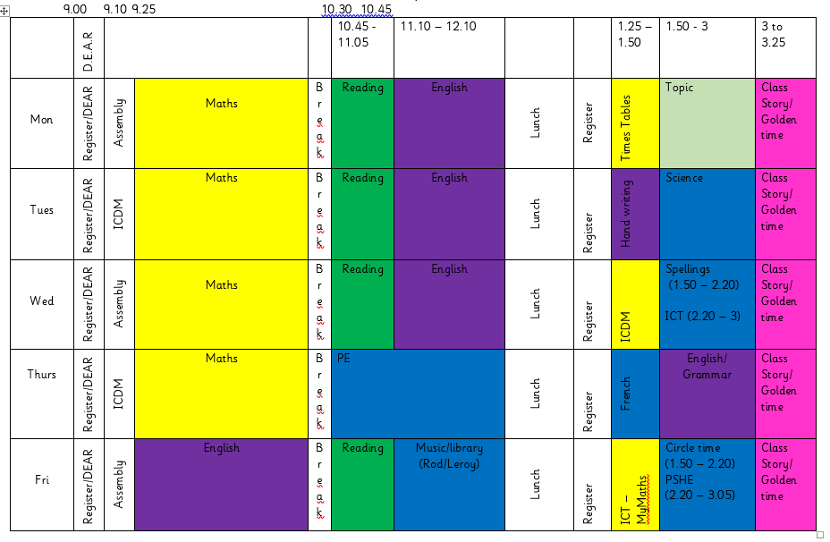
Class Timetables
Notes:
We have PE on Thursday and music on Fridays.
All pupils must have a PE kit

Slide 6
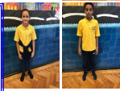
School Uniform
(Winter term)
P.E. uniform
Brecknock T. Shirt
Brecknock cardigan /sweatshirt
Blue or black tracksuit bottoms
Trainers
White T. Shirt
Blue or black tracksuit bottoms
Trainers
Uniform
Notes:
Pupils should come to school in the correct uniform everyday. If they do not they will be reminded by a member of staff. If they continue to wear the incorrect uniform the class teacher will talk with the child’s parent/carer at the end of the school day.
The school has a uniform policy to avoid pupils competing over clothing brands and to save parents having to buy expensive clothes for school.
However, if anyone is having difficulty providing their child with a school uniform, please speak to the office and we can help to organize one for you.

Slide 7
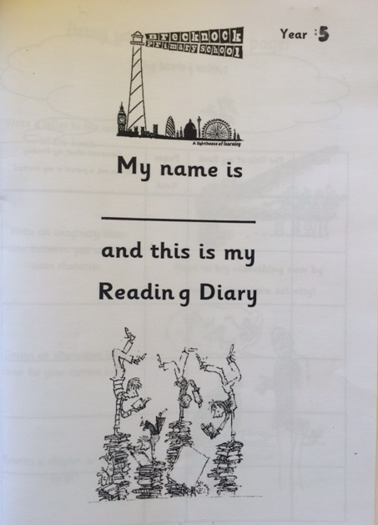
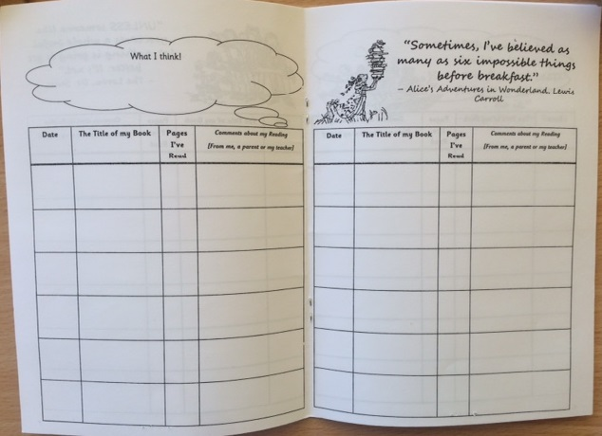
Daily Reading
Homework
Notes:
Pupils are expected to read for 30 minutes every evening in Year 3. Pupils will choose a book of their choice from one of the school libraries – classroom/ school / Reading Road Map.
Pupils are expected to take their book home every day, along with their Reading Diary. These need to be brought back to school every day.
Parents are expected to hear their child read, and/or ask them questions about the book they are reading. Reading diaries are for parents and teachers to communicate with each other about how their child’s reading is progressing. It is not to be filled in by the child.
If you have difficulty reading in English with your child, read/ listen to your child reading in your own language, this is as beneficial.
Please also inform the school, so we can provide additional support for your child to read in English at school.
Reading is the most important skill pupils will learn as it allows them to access information about subjects they are interested in. Further to this, reading tests in both Primary and secondary level have become more rigorous in recent years. In order to best prepare our pupils for these exams, it is essential that we encourage their love of reading and understanding of a range of texts.

Slide 8
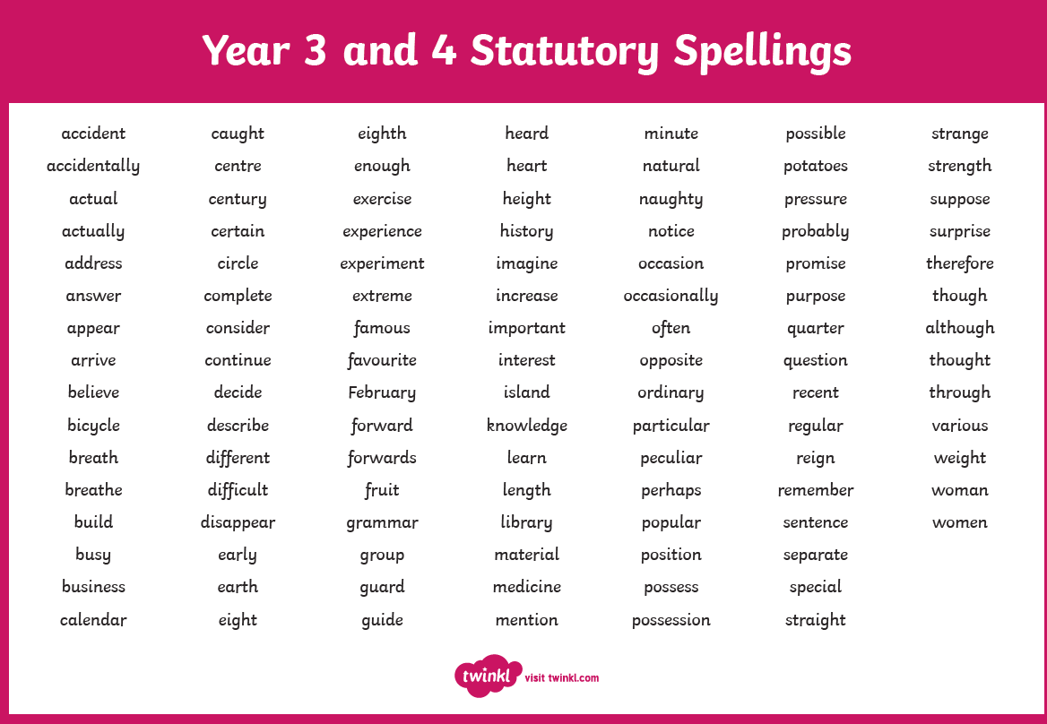
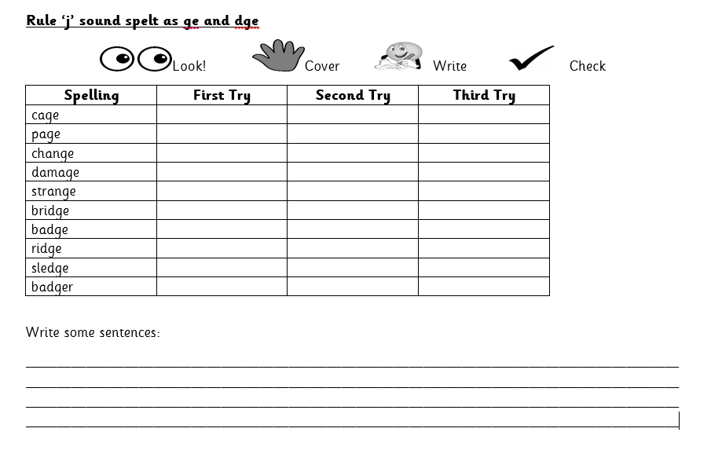
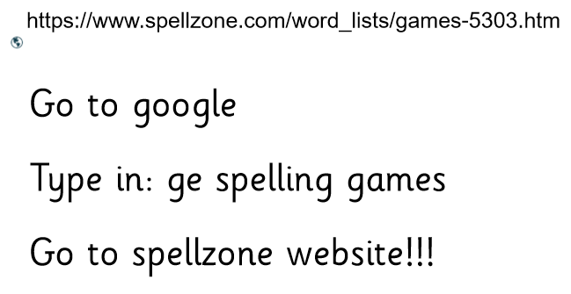
Weekly maths and spelling
Spelling
Homework
Notes:
Improving your child’s knowledge of key skills is the best way of ensuring their success this year.
Times tables, number sense, spelling, vocabulary and grammar are the bed rocks of maths and English. Without these key skills, your child’s progress is severely hampered.
Every week your child will be given a spelling rule and some words that follow this rule to learn. Your child needs to learn the rule, not just the words, so they can apply it to other words. For example by learning that the sound ‘f’ at the end of the word rough is made using two letters – ‘gh’, means that your child can apply this knowledge to spell the word: tough, enough etc. Similarly, if you child knows their 3 times tables they can use this knowledge to determine what 3 x 35 – by multiplying 3 x 30 and 3 x 5 and adding the answers together.

Slide 9
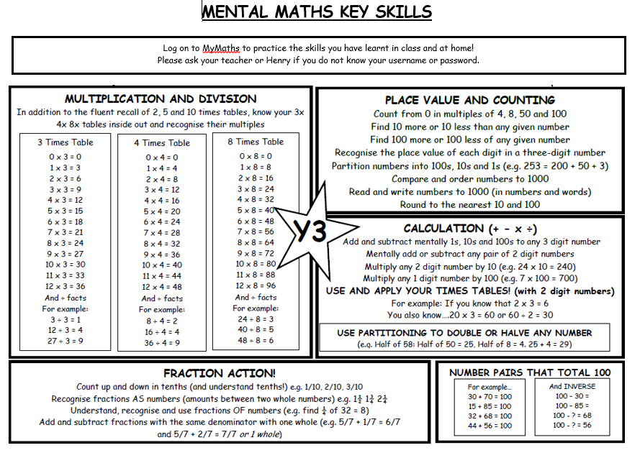
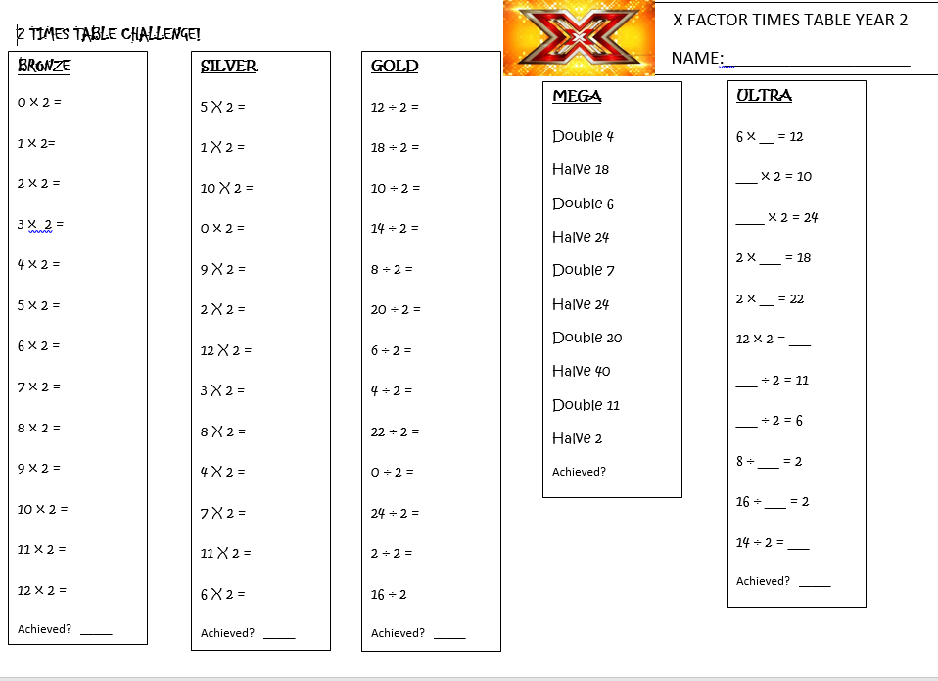
Maths and times tables
Homework – times tables

Slide 10
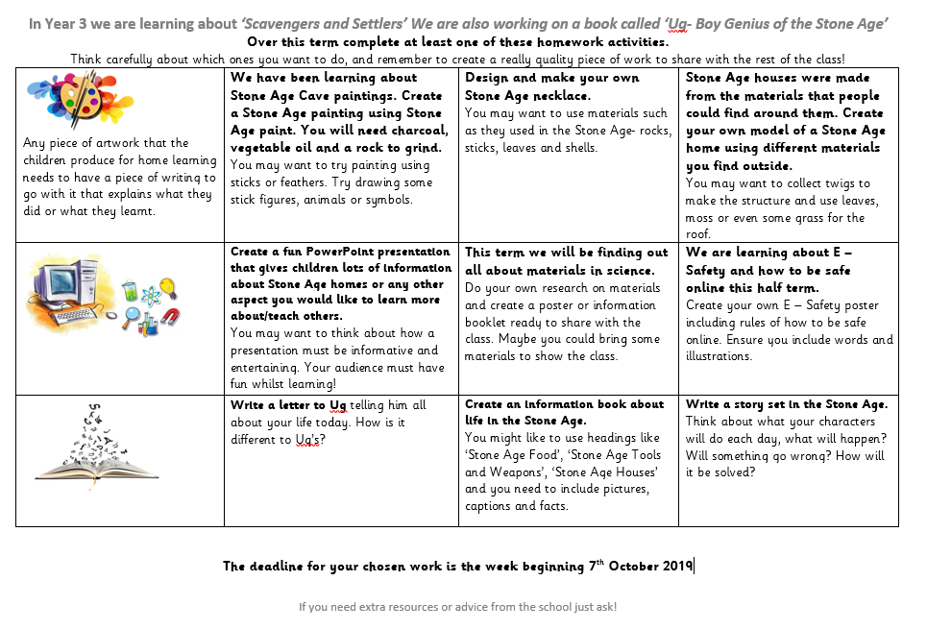
Matrix
Homework
Notes:
Pupils are expected to complete a matrix task every half-term. These complement our curriculum by adding more cross-curricular links. They are an opportunity for pupils to explore learning independently and at their own pace. Parents are encouraged to work alongside their child in completing these tasks.
Finished pieces will form part of Exit Point celebrations, where parents will be invited to come to school to hear and see what their child has been learning about.

Slide 11
Helping at home
Attendance
• Punctuality
• Attitude when arriving at school
• Completing homework
• Join a library and encourage your child to read a
range of book genres
• Talking through your child's school day
• Helping them to be responsible
• Ensuring they are getting enough sleep & exercise
Support

Slide 12
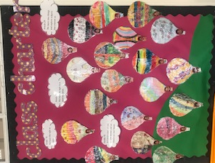
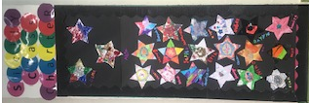
Class Charter
Playground Charter
Behaviour expectations
Notes:
At the start of the year each class decided on rules they think are important for the class to follow to ensure that pupils feel safe, supported and happy. These were generated through a class discussion and using the articles from the UN’s Children’s Rights Articles. As a rights respecting school we put pupils’ voice first. We encourage pupils to express their thoughts and feel confident to speak up if they feel they have been treated unfairly.
We also have a Playground Charter that was created by class ambassadors. These ambassadors were chosen through a pupil vote. The articles that were chosen were thought to best meet how pupils wished the playground environment to be.

Slide 13
Medical
Notes:
Pupils are encouraged to bring a water bottle to school when the weather is warm, so they can stay hydrated during lessons. Pupils are reminded to use the toilet and get water during playtime and lunch-time. They are not permitted to go to the toilet during lesson time as this interrupts learning. If your child has a medical condition and needs to use the toilet more regularly, please speak to the class teacher.
If your child has any medical issues please keep the school updated, particularly if they have medication that can expire.

Slide 14
E Safety

Slide 15
Class assembly dates
Corsica class Wednesday 2nd October 2019
Sicily class Wednesday 20th November 2019

Slide 16
End of day collection – 3.25
m.doherty@brecknock.camden.sch.uk
u.ahmed@brecknock.camden.sch.uk
Communication
Notes:
Pupils should be collected from the playground promptly at 3.25.
This is a perfect opportunity to speak to teachers that work with your child, about any concerns you may have, or to let them know important information about your child such as upcoming appointments.
If you do not pick up your child and would like to get in touch with a teacher, you can do so by emailing them directly. However, teachers are very busy, so please be patient and allow them up to 3 days to respond.

