Slide 1
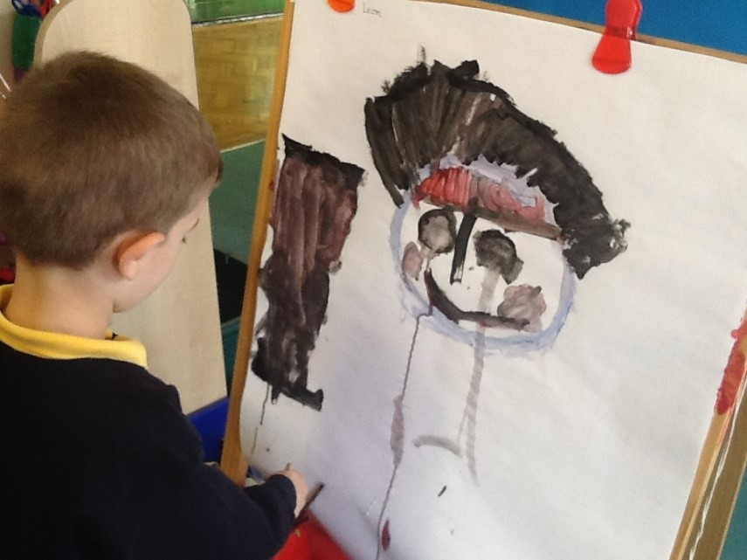
Welcome to Year 1’s Curriculum meeting
Welcome

Slide 2
Curriculum Map

Slide 3
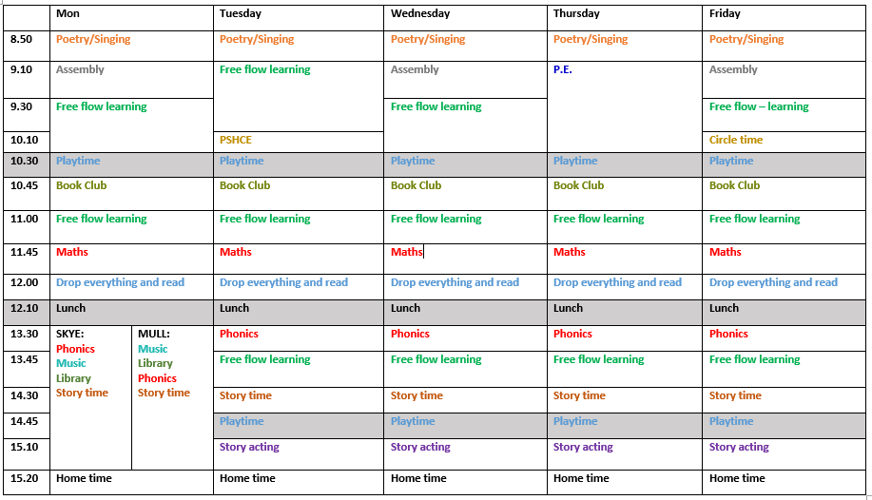
Class Timetables

Slide 4
Class Charter
Playground Charter
Behaviour expectations

Slide 5
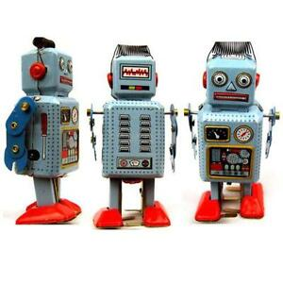
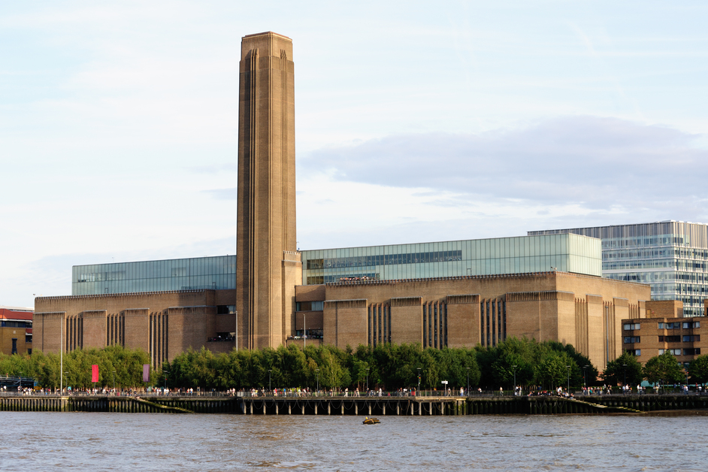
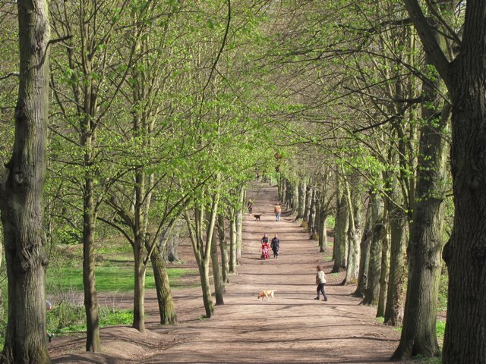
History - V&A Museum of Childhood
Art -Tate Modern
Geography/Science – Hampstead Educational Centre
Trips

Slide 6
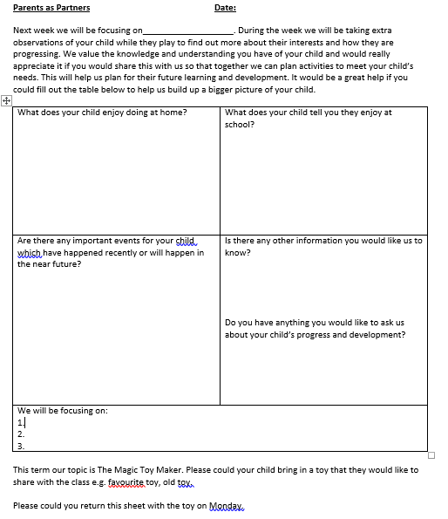
Parents as Partners
Home learning

Slide 7
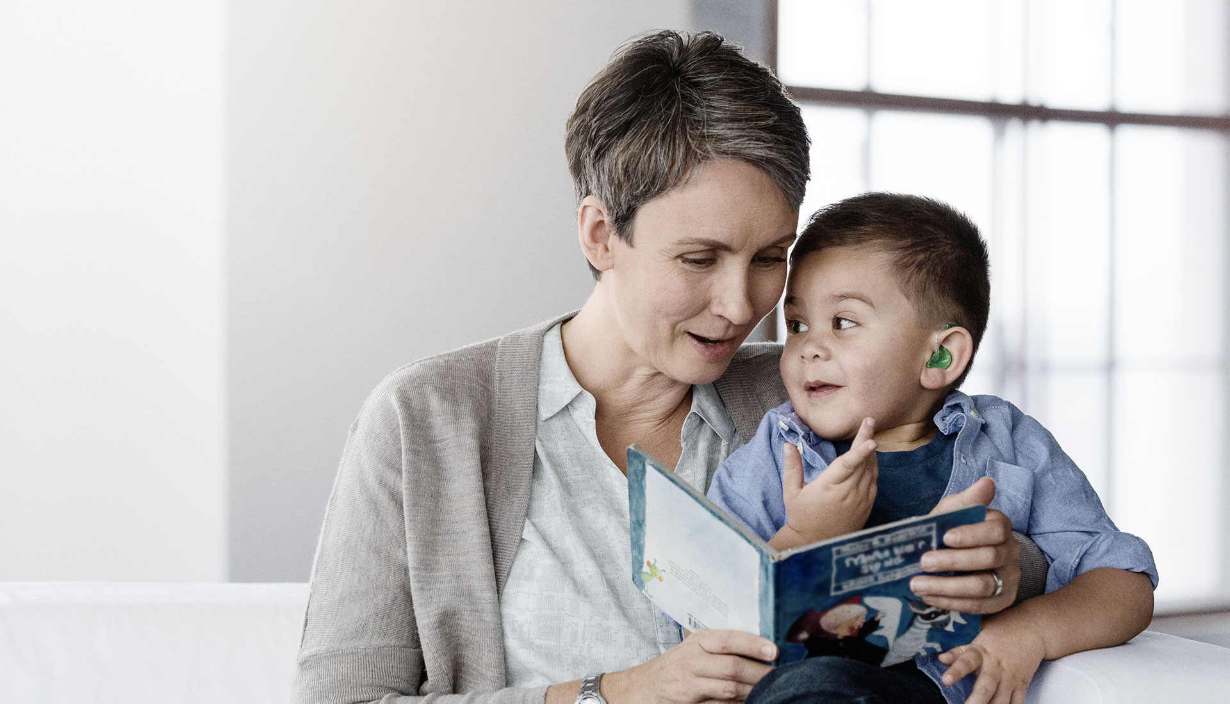
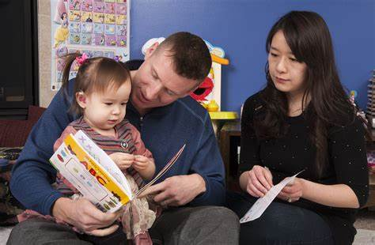
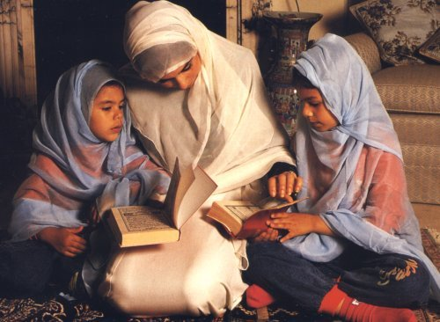
Daily Reading
Home learning

Slide 8
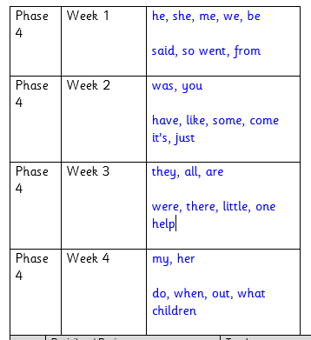
Maths, spelling, handwriting
Home learning

Slide 9
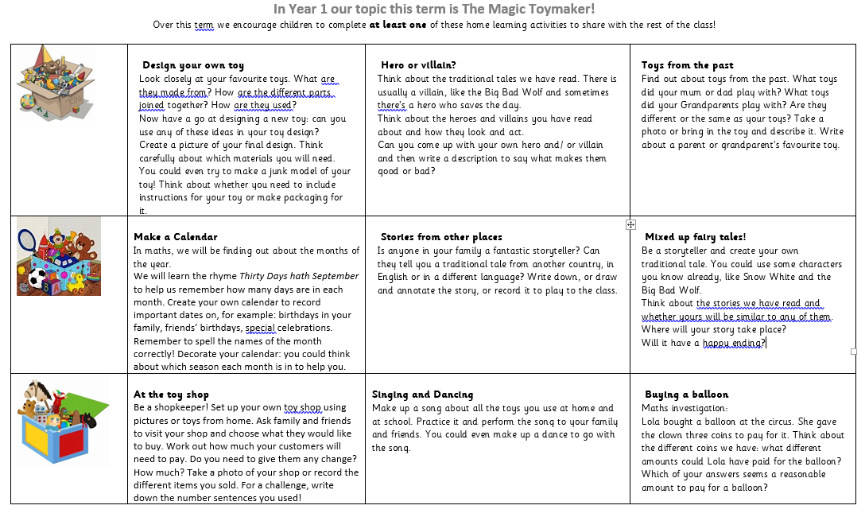
Matrix
Home learning

Slide 10
School Uniform
(Winter term)
P.E. uniform
Brecknock Polo shirt
Brecknock cardigan /sweatshirt
Navy blue tracksuit bottoms/skirt/pinafore
Trainers/sensible shoes with grip
Coat with hood
Hat / gloves
White T. Shirt
Blue tracksuit bottoms/shorts
Trainers
Uniform

Slide 11
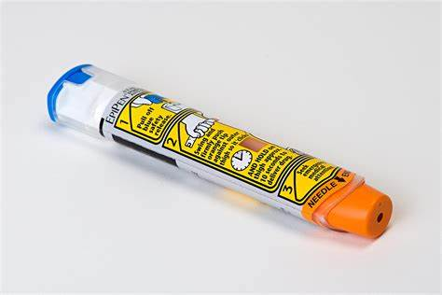
Medical

Slide 12
E Safety

Slide 13
End of day collection – 3.25 pm
l.lien@brecknock.camden.sch.uk
j.breach@brecknock.camden.sch.uk
h.wedmore@brecknock.camden.sch.uk
Any questions?
Communication

