Slide 1
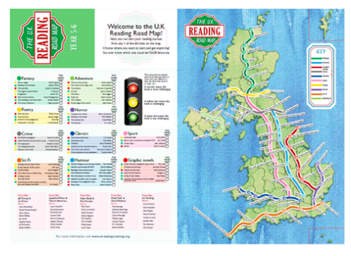
Reading Road Map
60 books
Books use a traffic light system:
red = more challenging
Yellow = challenging
Green = less challenging
10 genres
Start wherever you like

Slide 2
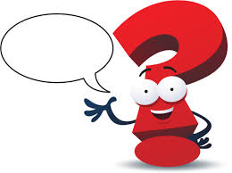
How does the Road Map work?
Every pupil will receive a copy of the Road Map. This will help you find new books and genres that you will enjoy.
Each time you finish reading a book, you will be asked a question about it, your Road Map will be signed off by Lisa and you will receive a sticker.
Books can be borrowed and returned in Madagascar Class between 12:30 – 13:00, daily.

Slide 3
What if I don’t know what book I will like?
Pupils will tweet on the school website.
Short reviews will be wrapped around books that have been read.
A pupil will summarise a book they have read in an assembly each week.
Ask a friend for a recommendation.
Need more help?
At the bottom of your Road Map there are suggestions of authors who are similar to popular authors. For example:
if you like Jeff Kinney and Liz Pichon – try: Gary Northfield or Emer Stamp

Slide 4
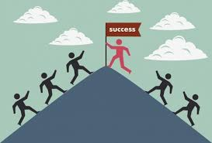
Rewards
When you read 5 books you receive a Bronze Certificate
When you read 10 books you receive a Silver Certificate
When you read 20 books you receive a Gold Certificate
When you read 40 books you receive a Platinum Certificate
Your face will appear on a school display to show how many book s you have read throughout the year.

Slide 5
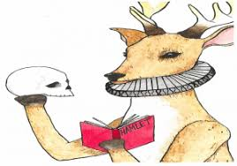
When can you read your book?
Before register in the morning.
After lunch, during D.E.A.R.
After school

Slide 6
Book Club
An exciting new Book Club will take place once a week, after school.
This club will include exploring books through games, drama, debate, and other media formats eg: magazines, computer games, films and other books.
Snacks will be provided.
There are a limited number of places, so sign up quickly to secure your place.

