Slide 1
https://www.youtube.com/watch?v=IscHzOc9P1s
Lower Treginnis
St Davids
Pembrokeshire
SA62 6RS

Slide 2
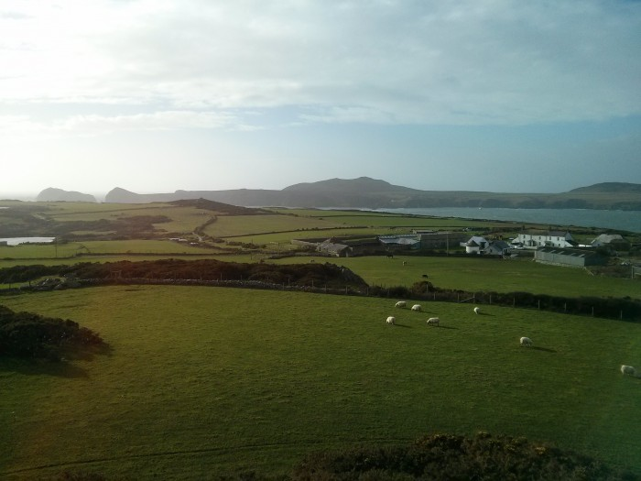
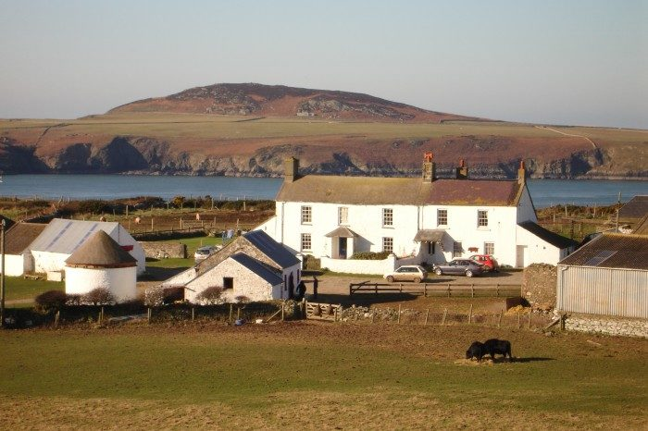
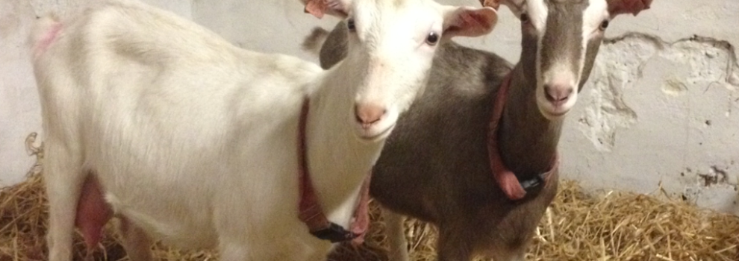
TRAVEL
Lower Treginnis

Slide 3
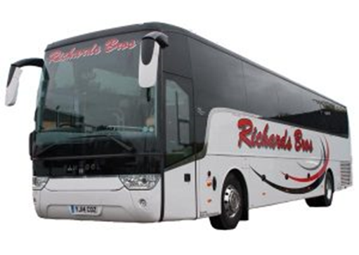
We are using a reliable company, recommended and used by the charity.
The journey will take approximately 6 hours.
Children should pack a ‘lunch’ for this journey.

Slide 4
Children are allowed to bring electronic devices for the journey.
After the journey, electronic devices will be safely stored by the teacher for the duration of the trip.
Phone devices are NOT allowed.
Part of purpose of the trip is to disconnect with our technology driven world.

Slide 5
Madagascar Class
OUTBOUND -
Leave Brecknock on Friday 23rd November (7 am)
Arrive at Tregennis on Friday 23rd November (2 pm)
RETURN -
Leave Tregennis on Monday 26th November (7am)
Arrive at Brecknock on Monday 26th November (3 pm)
Sumatra Class
OUTBOUND -
Leave Brecknock on Monday 26th November (7 am)
Arrive at Tregennis on Monday 26th November (2 pm)
RETURN -
Leave Tregennis on Thursday 29th July (7am)
Arrive at Brecknock on Thursday 29th July (3 pm)

Slide 6
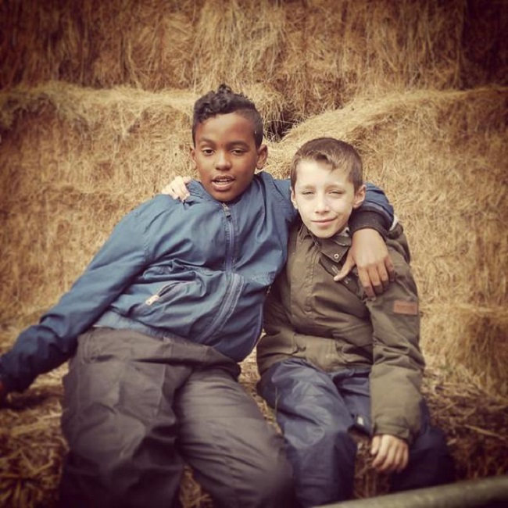
GENERAL INFORMATION
The children are encouraged to take full responsibility for the work they do, caring for the animals and the land. The experience stretches them physically, emotionally and intellectually in ways not possible in the classroom, building their confidence and nurturing a real sense of achievement.

Slide 7
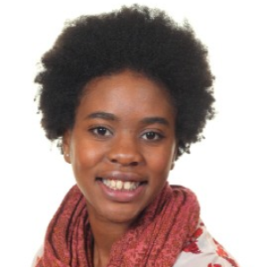
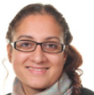
Madagascar Class
Sumatra Class
Muriel
Henry
Yetunde
John
Sabrina
Lisa
Louise
John
Sabrina
There will be daily tweets and pictures to the school website.
Should you wish to contact the group please use the contact number given or farm’s landline.

Slide 8
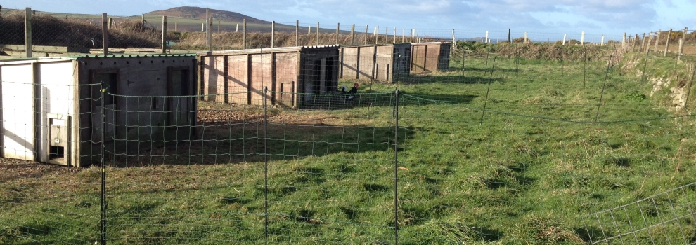
Each of the farms are staffed by a combination of Farm School Manager with a background in teaching and Farm Managers with responsibility for the farm work and outdoor environment.
There are also cooks, housekeepers and domestic staff who provide a welcoming and caring atmosphere at each centre, and farm workers employed to work directly with the children outside.

Slide 9
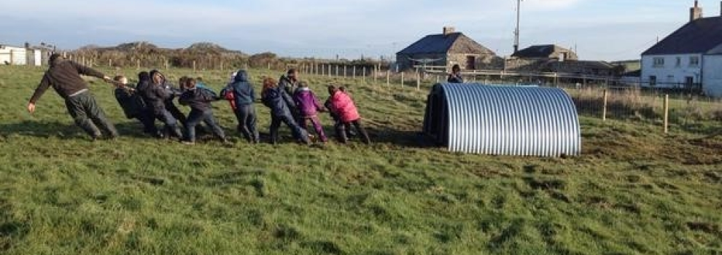
The children will be placed into 3 farm work groups, accompanied by one school adult. The school adult will stay with their group and actively participate alongside and encourage the children.
At Lower Treginnis, Farms for City Children works in partnership with organic farmer Rob Davies, who keeps 850 sheep and a small herd of Hereford X calves on the surrounding land. In addition the children help look after poultry, horses, donkeys, milking goats and a breeding herd of pigs.
A shop is open once during the week, selling cards, pencils, a selection of Michael Morpurgo books, soaps, lip balms, teddy bears, t-shirts and a lot, lot more.
Money is optional, a maximum of £10 is recommended.

Slide 10
There are 4 children’s dormitories on the first floor for the GIRLS Porthclais sleeps 8 with an en-suite shower room /Porth Llisgi sleeps 6 / Henllys sleeps 4 / Y Ffald sleeps 7 with an en-suite shower room Justinian on the first floor sleep 2 for FEMALE staff
SLEEPING…
There are 3 children’s dormitories on the ground floor for the BOYS
Ramsey sleeps 6 / Buzzard sleeps 6 / Half Tide sleeps 8
Bishop and Dovecote on the ground floor sleep 2 each for MALE staff.

Slide 11
LET US KNOW…
If you have anything you would like to tell us about your child’s daily routines please feel free to let us know.
We want to provide the best experience possible and make some lasting memories¬

Slide 12
FOOD AND EATING…
Alternative menus and dietary requirements will be provided. Please ensure dietary and medical forms are returned to enable the Cooks to plan and order for your visit.
The farm ask children not to bring sweets/crisps/fizzy drinks etc.
They serve 3 delicious meals every day, a morning snack and hot chocolate at bedtime.
Learning about healthy eating as well as the social aspects of eating together is a very important part of the week.

Slide 13
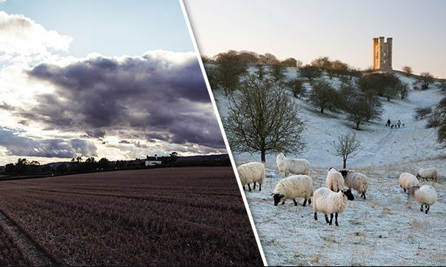
WHAT YOU NEED TO BRING…
A light lunch and snacks for the outbound journey.
Electrical entertainment is allowed.
AT THE FARM
Warm thermals, jumpers, hat, scarf and gloves!
Spare coat for the journey home and any walks off the farm.
Trainers to wear indoors
Wellies for the farm
Nightclothes
Slippers and dressing gown for evenings
Towel and wash bag
EXTRA WATERPROOF COATS AND TROUSERS ARE NOW PROVIDED BY THE FARM.
Please note: waterproofs are worn as protective overalls, at all times out on the farm, whatever the weather, and are essential for everyone.
Plenty of normal old clothes – the children will get dirty!

