Slide 1
Brecknock Primary School 2016
T
Brecknock believes that Road Safety Should Take More Notice of Pedestrians

Slide 2
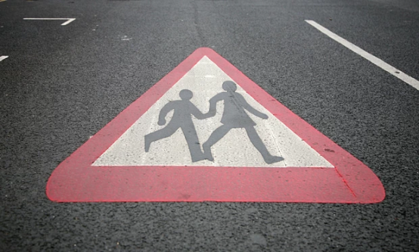
P
INTRODUCTION
We think road safety is so important because many children go home by themselves and drivers don’t take enough care.
In 2014 the annual figure for child deaths and serious injuries on the roads has increased by 3% compared with the 12 months to September 2013,

Slide 3
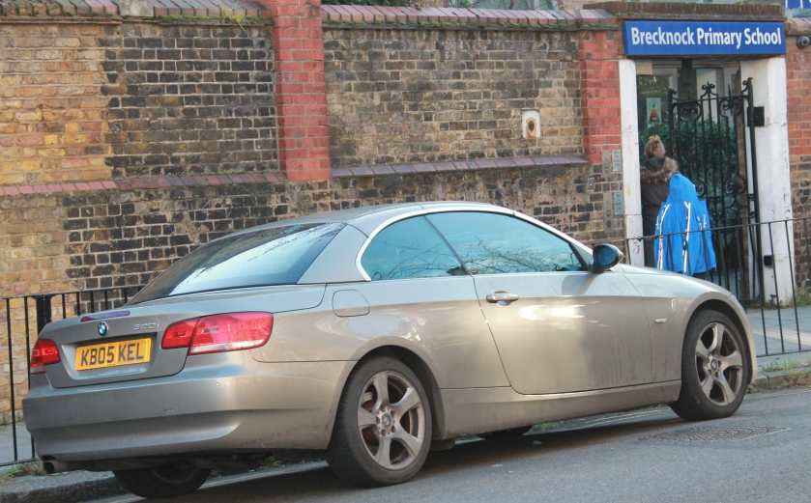
Z
We will be looking at
Bad parking
People crossing roads when they shouldn’t
Longer times to cross at timed crossings
Crowded pavements (Wheelchairs in the road)
Bikes going on pavements and going through red lights
Narrow roads that should be one way

Slide 4
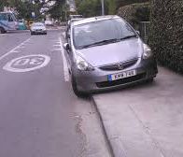
C
Bad Parking
Due to narrow pavements, when a car parks badly the pedestrians have to walk on the road.
We suggest more traffic wardens around schools and elsewhere looking out for this particular problem.

Slide 5
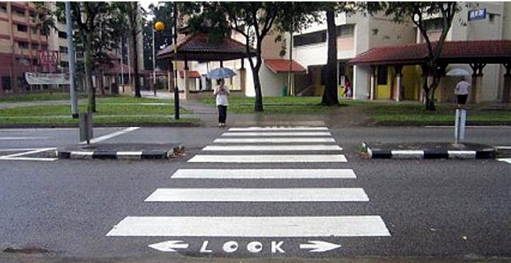
T
People crossing roads where they shouldn’t .
This can cause accidents, serious injury and EVEN death.
Perhaps Camden needs more zebra or pelican crossings.

Slide 6
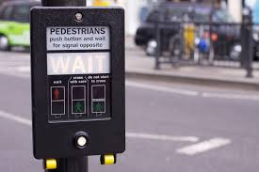
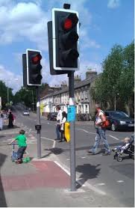
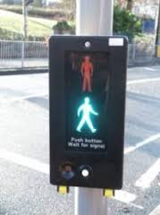
P
Longer times to Cross at Crossings
Sometimes when the crossings are counting down people run just as the cars are starting to move.
The elderly and parents with very young children need longer to cross.
Could Camden lengthen the timed crossings near schools?

Slide 7
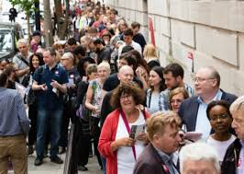
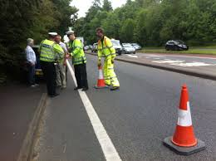
Z
Crowded Pavements.
There are many reasons for crowded pavements, tourists ,queuing, sales and especially outside schools before 9 am.
We have asked for the pavement outside our school to be widened to stop any possible accidents. Can Camden do this for all schools?

Slide 8
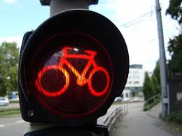
C
Bikes going on pavements and going through red lights
This problem can cause crashes or pedestrians being forced suddenly onto the road and into traffic.
Everybody knows this is incredibly dangerous and a risk to public safety.

Slide 9
T
Narrow Roads that should be one way.
This means that to get past they will either have to go up on the pavement or one car will have to reverse. In front of our school, this has even caused road rage, with adults behaving VERY badly (in front of children!)
T

Slide 10
P
In conclusion, we in Brecknock believe that Road Safety Should Take More Notice of Pedestrians and Camden should do more to help in this.
The figure of 2,412 children killed or seriously injured in the UK in year 2011* has fallen to 2,082 in 2014. However it is still a shocking and disgustingly high number and with a little effort and a few changes, we can reduce this dreadful number even more.
*Figures published by the Department for Transport show that in 2011, 2,412 children under the age of 16 were killed or seriously injured on the roads.

